Slide 1
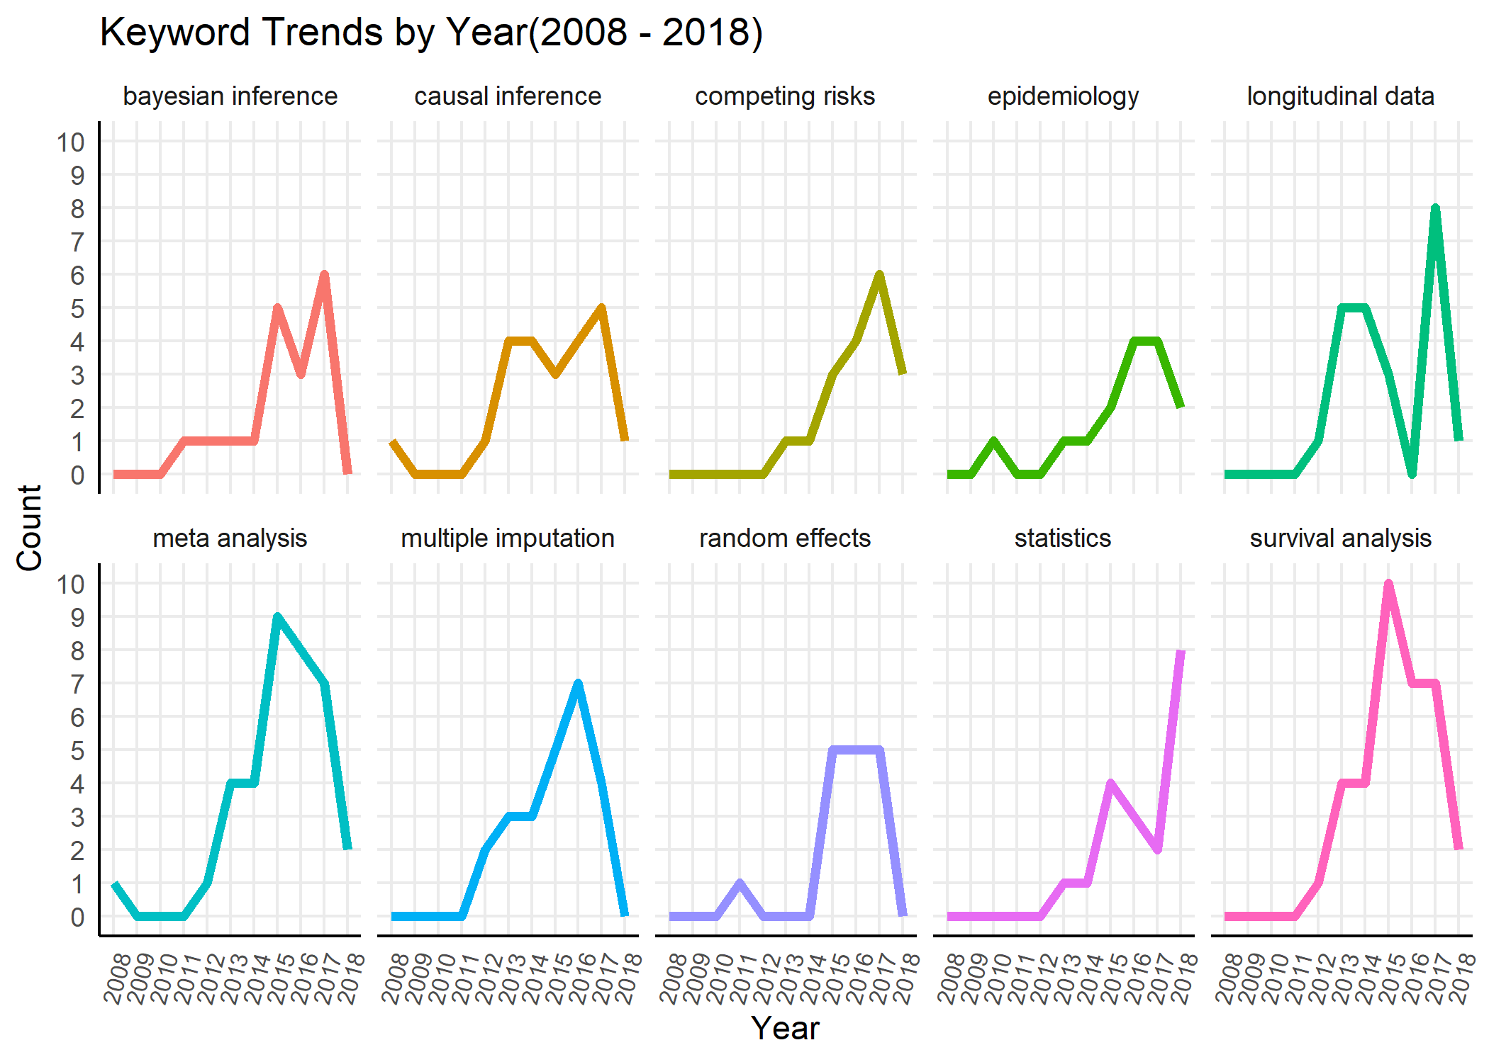
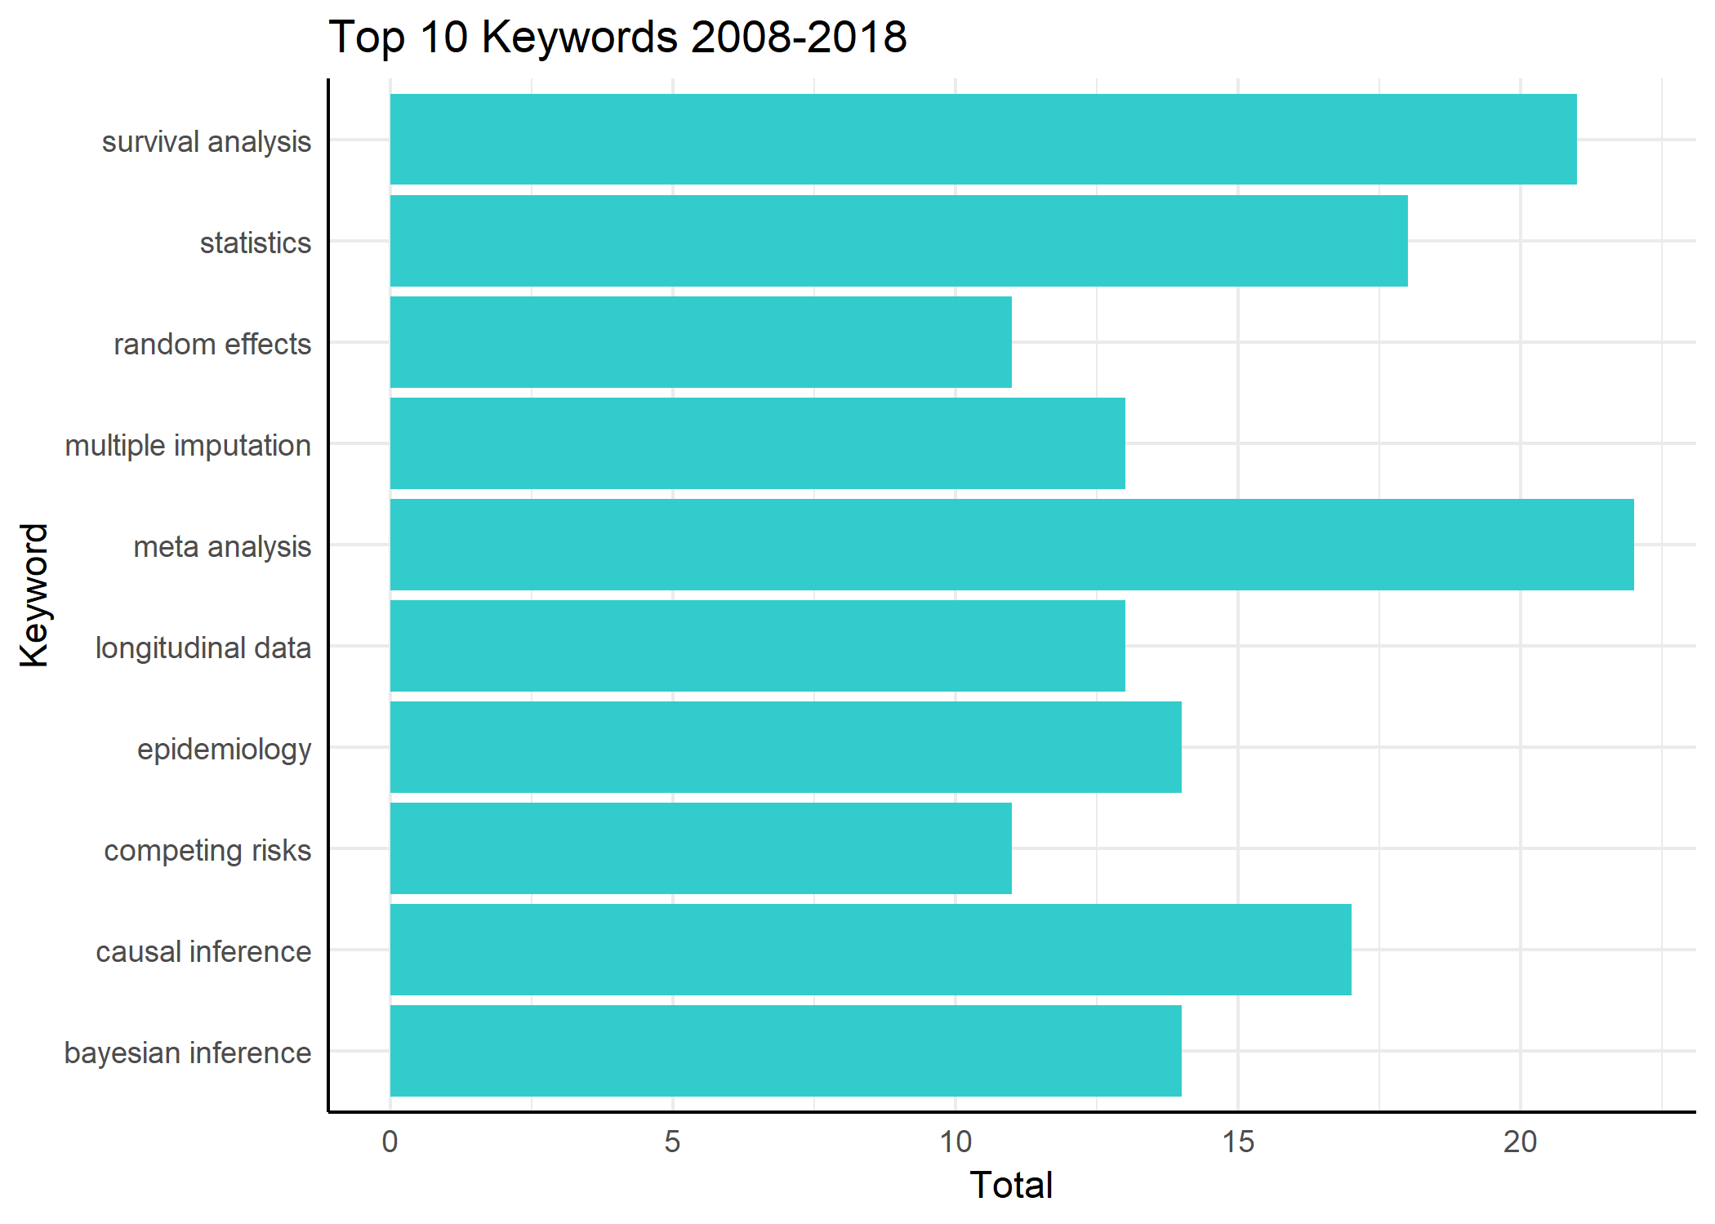
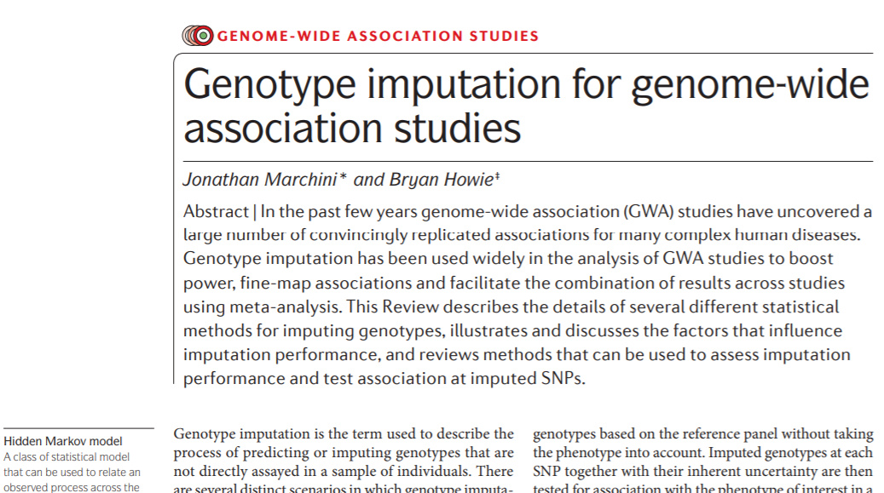
R Package Outline
Functions
Sum_key function(search, year)
Output: data frame with keywords, with their totals
year_key function(search, year)
Output: data frame with keywords, with their totals by each year
key_data function(search, year)
Output: data frame with title, author, keywords, year, and DOI included
graph_key_b function(search, year, n_terms)
Output: ggplot bar graph which shows the trends by year
graph_key_l function(search, year, n_terms)
Output: ggplot line graph with facet grids which shows the trends by year
Shiny App Outline
Search Terms
Graph
Enter Search Terms Here
Select
------------
Trends
Totals
Number of Keywords
Select (Default 10)
---------------------------
1
2
3
4
5
OR
Year(s) (Default all)
YYYY
To
YYYY
First Article
first.article.doi.link.here
OR
PDF here
Results
key.data.csv

